Slide 1
Vehicle Routing Problem
Optimizing Delivery Routes for Distribution company
GROUP - 5
1
15. 9. 2023

Slide 2
Members
Mg Thwin Htoo Aung (5IST-1)
Ma Htoo Mon Kyaw (5IST-3)
Mi Than Than Soe (5IST-6)
Ma Htet Eaindra Win (5IST-9)
Ma Shwe Yee Lin Let (5IST-10)
Mg Ye Win Htet (5IST-11)
Mg Mabu Phong (5IST-13)
Ma Poe Thandar Naing (5IST-14)
Ma Khine Thet Thet Zaw (5IST-16)
2

Slide 3
00
Project Summary
Our system is Vehicle Routing Problem(VRP) that involves the most efficient routes for vehicles to deliver goods to many customers while minimizing costs.
3

Slide 4
Outlines
01
Problem Outlook
Objective
Scope & Methodology
Implementation
05
Solving the problem
02
03
04
Our system is Vehicle Routing Problem(VRP) that involves the most efficient routes for vehicles to deliver goods to many customers while minimizing costs.
06
Result
Analysis
4

Slide 5
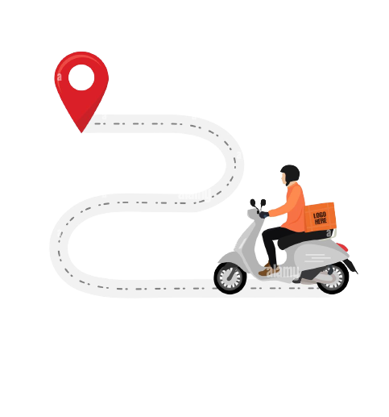
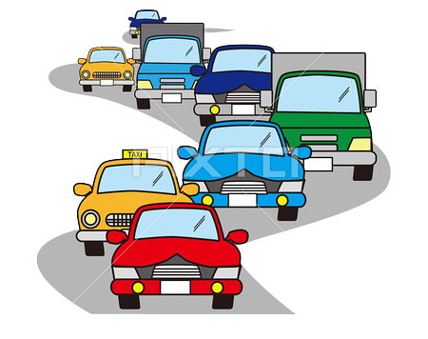



01
Problem Outlook
Delivery companies often face Several challenges in their operations.
1
Driver Stress
2
Traffic congestion
3
Customer expectation
4
Competitive market
5
Environmental concern
[ Carbon footprint]
5

Slide 6

02
Objectives
To minimize travel time
To optimize delivery route to reduce costs
To deliver goods to multiple location
6

Slide 7
03
Scope & Methodology
Statement: We will implement the vehicle routing problem (VRP) for a delivery company, an example, Ninja Van. Our goal is to find optimal routes for multiple vehicle visiting a set of locations. Our optimal route is to minimize the length of the longest single route among all vehicles.
Ninja van is a tech-enabled express delivery company providing hassle-free delivery services for businesses of all sizes across Southeast Asia. Launched in 2014, Ninja Van started operations in Singapore and has become the region’s largest and fastest growing last-mile logistics company, with a network covering six countries across Southeast Asia-Singapore, Malaysia, Philippines, Indonesia, Thailand and Vietnam.
7

Slide 8
Traveling Saleman Problem
The traveling salesman problem (TSP) is used to find shortest tour through a given set of n cities that visits each city exactly once before returning to the city where it started.
Tour
N → B → C → E → N
N → B → E → C → N
N → C → B → E → N
N → C → E → B → N
N → E → B → C → N
N → E → C → B → N
Length
L= 1100+600+825+715 =3240
L= 1100+795+825+700 =3420
L= 700+600+795+715 =2810 optimal
L= 700+825+795+1100 =3420
L= 715+795+600+700 =2810 optimal
L= 715+825+600+1100 =3240
E: November Sea food& Desert B: Iris Beauty
C: Infinix Shoe & Cloth N: Ninja Van
E
B
795m
825m
600m
715m
1100m
Number of permutations = (n -1)!
C
N
700m
8

Slide 9
VRP Example
Imagine the situation in which 16 customers at below locations are requested Ninja Van Company for delivery. What will Ninja Van do for shortest route?
1. Soon Children Education Centre
2. Taw Win Pan Guesthouse ( Shwe Si Gon Street )
3. Crossroad between Bogyoke Road and BanDuLa Street
4. Ko Lay Lone, Car Washing Service
5. Ngwe SaPalPhyu Hotel, traffic-light street, Near Pyin Oo Lwin Market
6. SP Bakery, traffic-light street
7. Zaw, Leather Cushions Shop
8. 1MK beauty salon & spa
9. MaAShan ,Shan Noodle Shop
10. AK Car Wash, Bo Gyoke Street
11. May Myo SaKhanThar Hotel
12. Pyin Oo Lwin Post Office
13. Cherry Lwin Cinema
14. ATK Fried Chicken Shop
MinGaLarDon Compound House, Beside Nan Myaing Street
Aung Myay, Home Agency (Shwe Bo Street)
9

Slide 10
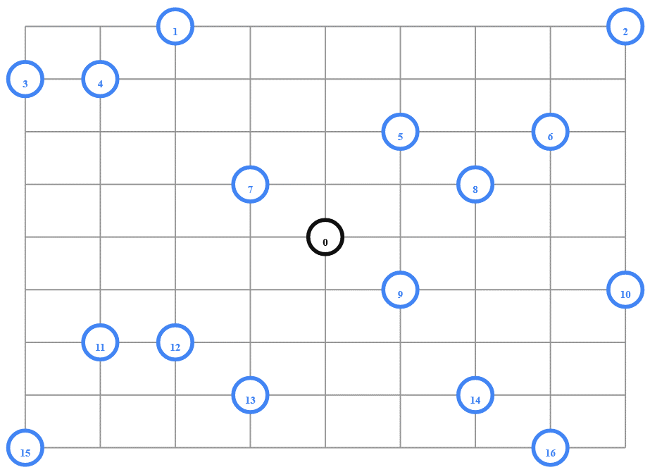

VRP Example
To be easy to understand, the following figure illustrates the situation of Ninja Van company that needs to visit its 16 customers in a city, with particular location and distance one other.
Customer node: 1-16
Company Deport node: 0
Let suppose Ninja Van
will use 4 vehicles.
10

Slide 11
VRP Example
The routing distances from each node to others are calculated by using Google-map’s measuring route feature, and distances are described in the following graph in distance-matrix form.
 | 0 | 1 | 2 | 3 | 4 | 5 | 6 | 7 | 8 | 9 | 10 | 11 | 12 | 13 | 14 | 15 | 16
0 | 0 | 548 | 776 | 696 | 582 | 274 | 502 | 194 | 308 | 194 | 536 | 502 | 388 | 354 | 468 | 776 | 662
1 | 548 | 0 | 684 | 308 | 194 | 502 | 730 | 354 | 696 | 742 | 1084 | 594 | 480 | 674 | 1016 | 868 | 1210
2 | 776 | 684 | 0 | 992 | 878 | 502 | 274 | 810 | 468 | 742 | 400 | 1278 | 1164 | 1130 | 788 | 1552 | 754
3 | 696 | 308 | 992 | 0 | 114 | 650 | 878 | 502 | 844 | 890 | 1232 | 514 | 628 | 822 | 1164 | 560 | 1358
4 | 582 | 194 | 878 | 114 | 0 | 536 | 764 | 388 | 730 | 776 | 1118 | 400 | 514 | 708 | 1050 | 674 | 1244
5 | 274 | 502 | 502 | 650 | 536 | 0 | 228 | 308 | 194 | 240 | 582 | 776 | 662 | 628 | 514 | 1050 | 708
6 | 502 | 730 | 274 | 878 | 764 | 228 | 0 | 536 | 194 | 468 | 354 | 1004 | 890 | 856 | 514 | 1278 | 480
7 | 194 | 354 | 810 | 502 | 388 | 308 | 536 | 0 | 342 | 388 | 730 | 468 | 354 | 320 | 662 | 742 | 856
8 | 308 | 696 | 468 | 844 | 730 | 194 | 194 | 342 | 0 | 274 | 388 | 810 | 696 | 662 | 320 | 1084 | 514
9 | 194 | 742 | 742 | 890 | 776 | 240 | 468 | 388 | 274 | 0 | 342 | 536 | 422 | 388 | 274 | 810 | 468
10 | 536 | 1084 | 400 | 1232 | 1118 | 582 | 354 | 730 | 388 | 342 | 0 | 878 | 764 | 730 | 388 | 1152 | 354
11 | 502 | 594 | 1278 | 514 | 400 | 776 | 1004 | 468 | 810 | 536 | 878 | 0 | 114 | 308 | 650 | 274 | 844
12 | 388 | 480 | 1164 | 628 | 514 | 662 | 890 | 354 | 696 | 422 | 764 | 114 | 0 | 194 | 536 | 388 | 730
13 | 354 | 674 | 1130 | 822 | 708 | 628 | 856 | 320 | 662 | 388 | 730 | 308 | 194 | 0 | 342 | 422 | 536
14 | 468 | 1016 | 788 | 1164 | 1050 | 514 | 514 | 662 | 320 | 274 | 388 | 650 | 536 | 342 | 0 | 764 | 194
15 | 776 | 868 | 1552 | 560 | 674 | 1050 | 1278 | 742 | 1084 | 810 | 1152 | 274 | 388 | 422 | 764 | 0 | 798
16 | 662 | 1210 | 754 | 1358 | 1244 | 708 | 480 | 856 | 514 | 468 | 354 | 844 | 730 | 536 | 194 | 798 | 0
We can add some capacity constraints:
Number of vehicles= 4
Vehicle capacities = [15, 15, 15, 15]
Demands of each node= [0, 1, 1, 2, 4, 2, 8, 8, 1, 2, 1, 2, 4, 4, 8, 8,5]
11

Slide 12
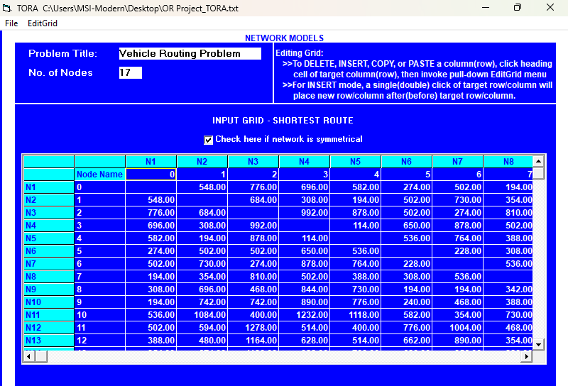
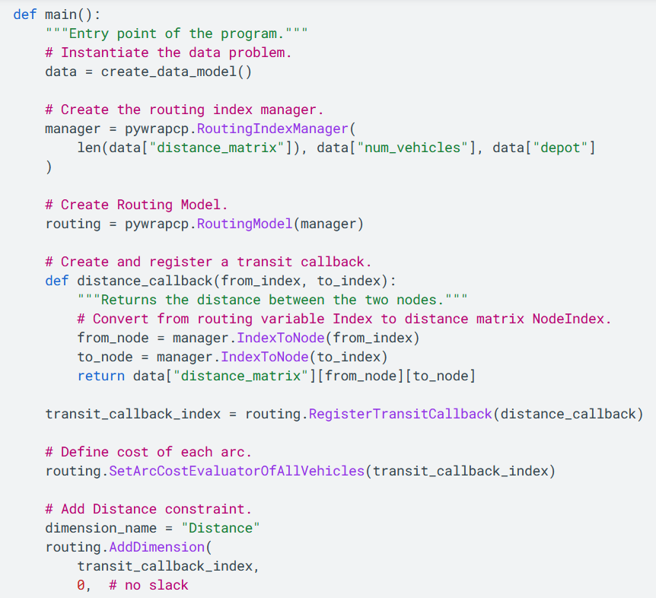
Implementation
We will input these distance routes and the limitation constraints of capacity and resources into the following two software tools.
In TORA software, we can only calculate the shortest route from one location to another.
In Python’s or-tools modules, we can use built-in methods and functions to calculate VRP.
12

Slide 13
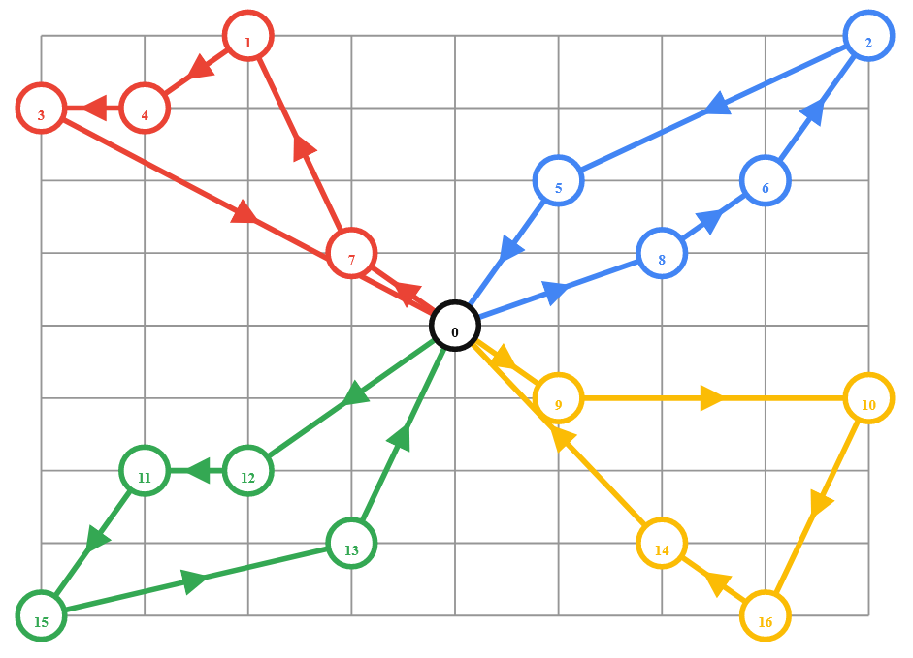
Result from OR Tools
Route for vehicle 0 : 0→ 7→ 1→ 4→ 3→ 0
Distance = 1552m
Load of route = 15
Route for vehicle 1: 0→9→10→16→14→0
Distance = 1552m
Load of route = 15
Route for vehicle 2: 0→12→11→15→13→0
Distance = 1552m
Load of route = 15
Route for vehicle 3: 0→ 8→ 6→ 2→5→0
Distance = 1552m
Load of route = 15
To be easy to understand, our team draw the following routing graph with the routing result.
Total Distance = 6208m
Total load of all routes = 60
13

Slide 14
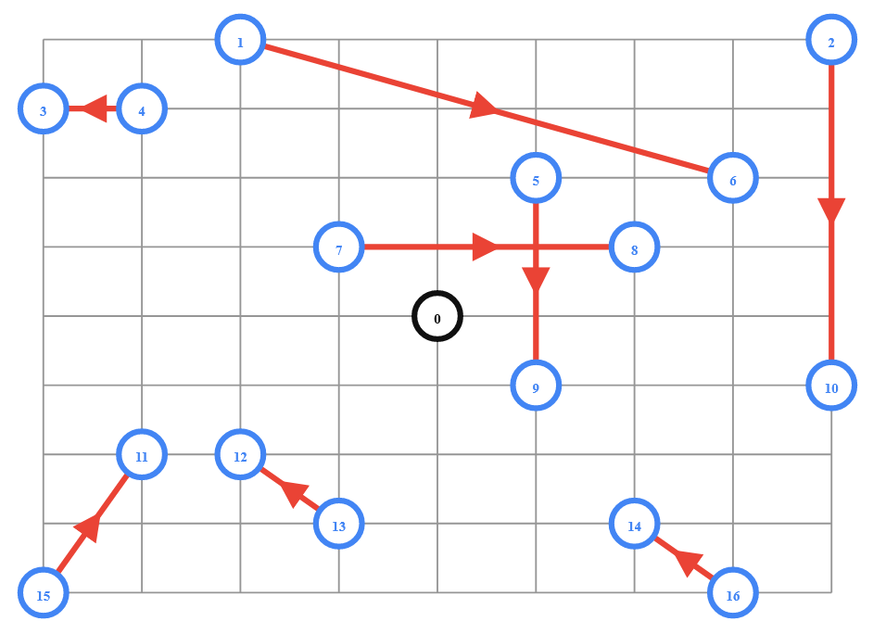
VRP with Pickup and Deliveries
Our customer requirements are not always simple.
Imagine our customer requirements are to pickup from a certain location to deliver at another location:
For example:
Pickup -------------> Delivery
1 -------------> 6
2 -------------> 10
4 -------------> 3
5 -------------> 9
7 -------------> 8
15 -------------> 11
13 -------------> 12
16 -------------> 14
From
To
Our updated constraints in or-tools module:
Pickup & Deliveries = [ [1, 6], [2, 10], [4, 3], [5,9 ],[7, 8], [15, 11], [13, 12], [16, 14] ]
Number of vehicles = 4
Vehicle maximum travel distance = 3000
14

Slide 15
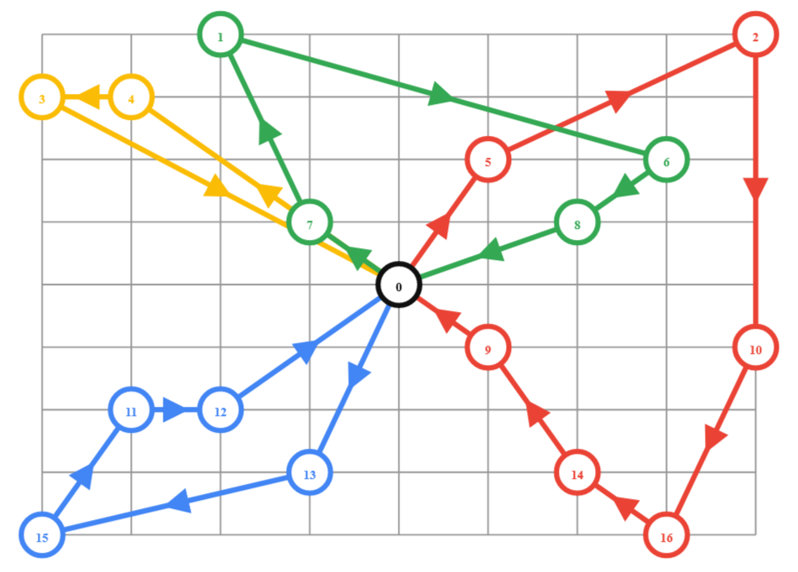
Solution
The output of our program:
To be easy to understand, our team draw the following routing graph with the routing result.
Route for vehicle 0: 0→13→15→11→12→0
Distance = 1552m
Route for vehicle 1: 0→5→2→10→16→14→9→0
Distance = 2192m
Route for vehicle 2: 0→4→3→ 0
Distance = 1392m
Route for vehicle 0: 0→7→1→6→8→0
Distance = 1780m
Total distance of all routes: 6916m
15

Slide 16
VRP with Time Window
Our VRP can handle customer customization, too. So, what does customer customization mean?
What if our customer requirement is to deliver goods within their customized specific time periods?
For example:
Locations : Time Window range
1 : 7-12
2 : 10-15
3 : 16-18
4 : 10-13
5 : 0-5
6 : 5-10
7 : 0-4
8 : 5-10
Locations: Time Window range
9 : 0-3
10 : 10-16
11 : 10-15
12 : 0-5
13 : 5-10
14 : 7-8
15 : 10-15
16 : 11-15
So, we have to update the following constraint Time Window=[ (7, 12),(10, 15), (16, 18),(10, 13),(0, 5),(5, 10), (0, 4), (5, 10),(0, 3),(10, 16),(10, 15),(0, 5), (5, 10), (7, 8), (10, 15), (11, 15) ] and the time matrix. What is Time Matrix?
16

Slide 17
VRP with Time Window
What Time Matrix is
For different 16 locations, We calculate the travelling time from each location to other locations by Google-map and is described in the below graph in time-matrix form with example time data.
 | 0 | 1 | 2 | 3 | 4 | 5 | 6 | 7 | 8 | 9 | 10 | 11 | 12 | 13 | 14 | 15 | 16
0 | 0 | 6 | 9 | 8 | 7 | 3 | 6 | 2 | 3 | 2 | 6 | 6 | 4 | 4 | 5 | 9 | 7
1 | 6 | 0 | 8 | 3 | 2 | 6 | 8 | 4 | 8 | 8 | 13 | 7 | 5 | 8 | 12 | 10 | 14
2 | 9 | 8 | 0 | 11 | 10 | 6 | 3 | 9 | 5 | 8 | 4 | 15 | 14 | 13 | 9 | 18 | 9
3 | 8 | 3 | 11 | 0 | 1 | 7 | 10 | 6 | 10 | 10 | 14 | 6 | 7 | 9 | 14 | 6 | 16
4 | 7 | 2 | 10 | 1 | 0 | 6 | 9 | 4 | 8 | 9 | 13 | 4 | 6 | 8 | 12 | 8 | 14
5 | 3 | 6 | 6 | 7 | 6 | 0 | 2 | 3 | 2 | 2 | 7 | 9 | 7 | 7 | 6 | 12 | 8
6 | 6 | 8 | 3 | 10 | 9 | 2 | 0 | 6 | 2 | 5 | 4 | 12 | 10 | 10 | 6 | 15 | 5
7 | 2 | 4 | 9 | 6 | 4 | 3 | 6 | 0 | 4 | 4 | 8 | 5 | 4 | 3 | 7 | 8 | 10
8 | 3 | 8 | 5 | 10 | 8 | 2 | 2 | 4 | 0 | 3 | 4 | 9 | 8 | 7 | 3 | 13 | 6
9 | 2 | 8 | 8 | 10 | 9 | 2 | 5 | 4 | 3 | 0 | 4 | 6 | 5 | 4 | 3 | 9 | 5
10 | 6 | 13 | 4 | 14 | 13 | 7 | 4 | 8 | 4 | 4 | 0 | 10 | 9 | 8 | 4 | 13 | 4
11 | 6 | 7 | 15 | 6 | 4 | 9 | 12 | 5 | 9 | 6 | 10 | 0 | 1 | 3 | 7 | 3 | 10
12 | 4 | 5 | 14 | 7 | 6 | 7 | 10 | 4 | 8 | 5 | 9 | 1 | 0 | 2 | 6 | 4 | 8
13 | 4 | 8 | 13 | 9 | 8 | 7 | 10 | 3 | 7 | 4 | 8 | 3 | 2 | 0 | 4 | 5 | 6
14 | 5 | 12 | 9 | 14 | 12 | 6 | 6 | 7 | 3 | 3 | 4 | 7 | 6 | 4 | 0 | 9 | 2
15 | 9 | 10 | 18 | 6 | 8 | 12 | 15 | 8 | 13 | 9 | 13 | 3 | 4 | 5 | 9 | 0 | 9
16 | 7 | 14 | 9 | 16 | 14 | 8 | 5 | 10 | 6 | 5 | 4 | 10 | 8 | 6 | 2 | 9 | 0
17

Slide 18
Solution
By inputting these time matrix data and constraints in OR-Tool’s built-in functions, we can get the following solution.
Route for vehicle 0:
0→9→14→ 16→0
Time of the route:18min
Route for vehicle 1:
0→7→1→ 4→3→0
Time of the route:24min
Route for vehicle 2:
0→12→13→ 15→11→0
Time of the route:20min
Route for vehicle 3:
0→5→8→ 6→2→10→0
Time of the route:20min
By this way, delivery companies can support customer customized time period, while minimizing travel time.
Total time of all routes: 82min
18

Slide 19
Benefits of VRP
Cost Reduction
Improved Customer Service
Resource Optimization
Reduced Environmental Impact
Scalability
Customer Customization
19

Slide 20
Thanks!
Do you have any questions?
Contact Our Team

